Slide 1
Prophecy as a Human Phenomenon
Benj Fried
MTS Harvard Divinity School ‘12

Slide 2
Essential Questions
What kinds of prophetic activity are there?
What can we say is universal across cultures?
Who is a prophet?
How does a prophet gain gravitas?

Slide 3
The Ancient Near East Context
Mari (1900-1500 BCE)
Nineveh/Neo-Assyrian (700 BCE)

Slide 4
The Mari Tablets
Discovered by French Archaeologists in the 30s
25,000 tablets written in Akkadian
Kingdom of Mari was hub up the Euphrates River
Included among tablets were court archives featuring prophetic activity

Slide 5
What did we find?
Most prophecies saved were surrounding last king of Mari, Zimri-Lin
  Mari about to fall to Hammu-Rapi
Prophecies were letters addressed to king and had to do with affairs of the state

Slide 6
Vocabulary for Prophets
Muhhu
  Conveying “madness” or “ecstasy”
  Asinu
  Officials in the cult of Ishtar

Slide 7
Types of Activity
Divination over livers
Formal letters to king
Ecstatic fits
Performative aspect (biting head off animal as metaphor for predicted defeat in battle)

Slide 8
Types of Prophet
Shaman
  Healing the sick
  Raising the dead
  Performative
  Examples: Elijah, Elisha, Native American Kwakiutl healers

Slide 9
Types of Prophet
Social Justice/Social Commentator
  Ministers on behalf of the oppressed
  Points out social ills in society: poverty, hunger
  Examples: Amos, Deutero-Isaiah

Slide 10
Types of Prophet
Religious Reformer
  Oftentimes a temple official
  Attempts to overhaul religious practice or “return” the people to correct worship
  Example: Jeremiah (the Deuteronomist)

Slide 11
Types of Prophet
Historical Commentator
  Attempts to place traumatic historical events into the religious context
  Examples: 1st Isaiah, Nahum, Habbakuk

Slide 12
Types of Prophet
Community Organizer
  Tries to reconstruct the community or lead it to a new place
  This phenomena is particularly post-exilic
  Examples: Deutero-Isaiah, Trito-Isaiah

Slide 13
Types of Prophet
Apocalypse
  Predicts a vision for the end of the world or a time of restoration and reconciliation to God
  Examples: Daniel, 4th Isaiah (Isaiah 24-27)

Slide 14
Identifying Our Prophets
Questions to ask:
  Place within society
  How did the prophets get their gravitas

Slide 15
Place within Society
Insider verses Outsider
Insiders (Isaiah, Jeremiah, Nathan)
  Associations with scribal communities
  Ties to the monarchy
  Outsiders (Micaiah, Amos, Elijah)
  Not usually “ordained” or trained
  On the fringes of society
  Extremely oppositional to powers that be

Slide 16
Insider Verses Outsider: Micaiah vs. 400 Prophets (1 Kings 22)
2 And it came to pass in the third year, that Jehoshaphat the king of Judah came down to the king of Israel. 3 And the king of Israel said unto his servants: 'Know ye that Ramoth-gilead is ours, and we are still, and take it not out of the hand of the king of Aram?' 4 And he said unto Jehoshaphat: 'Wilt thou go with me to battle to Ramoth-gilead?' And Jehoshaphat said to the king of Israel: 'I am as thou art, my people as thy people, my horses as thy horses.' 5 And Jehoshaphat said unto the king of Israel: 'Inquire, I pray thee, at the word of the LORD today.' 6 Then the king of Israel gathered the prophets together, about four hundred men, and said unto them: 'Shall I go against Ramoth-gilead to battle, or shall I forbear?' And they said: 'Go up; for the LORD will deliver it into the hand of the king.'

Slide 17
7 But Jehoshaphat said: 'Is there not here besides a prophet of the LORD, that we might inquire of him?' 8 And the king of Israel said unto Jehoshaphat: 'There is yet one man by whom we may inquire of the LORD, Micaiah the son of Imlah; but I hate him; for he doth not prophesy good concerning me, but evil.' And Jehoshaphat said: 'Let not the king say so.' 9 Then the king of Israel called an officer, and said: 'Fetch quickly Micaiah the son of Imlah.'

Slide 18
13 And the messenger that went to call Micaiah spoke unto him, saying: 'Behold now, the words of the prophets declare good unto the king with one mouth, let thy word, I pray thee, be like the word of one of them, and speak thou good.' 14 And Micaiah said: 'As the LORD liveth, what the LORD saith unto me, that will I speak.' 15 And when he was come to the king, the king said unto him: 'Micaiah, shall we go to Ramoth-gilead to battle, or shall we forbear?' And he answered him: 'Go up, and prosper; and the LORD will deliver it into the hand of the king.' 16 And the king said unto him: 'How many times shall I adjure thee that thou speak unto me nothing but the truth in the name of the LORD?' 17 And he said: 'I saw all Israel scattered upon the mountains, as sheep that have no shepherd; and the LORD said: These have no master; let them return every man to his house in peace.' 18 And the king of Israel said to Jehoshaphat: 'Did I not tell thee that he would not prophesy good concerning me, but evil?' {S} 19 And he said: 'Therefore hear thou the word of the LORD. I saw the LORD sitting on His throne, and all the host of heaven standing by Him on His right hand and on his left. 20 And the LORD said: Who shall entice Ahab, that he may go up and fall at Ramoth-gilead. And one said: On this manner; and another said: On that manner. 21 And there came forth the spirit, and stood before the LORD, and said: I will entice him. 22 And the LORD said unto him: Wherewith? And he said: I will go forth, and will be a lying spirit in the mouth of all his prophets. And He said: Thou shalt entice him, and shalt prevail also; go forth, and do so. 23 Now therefore, behold, the LORD hath put a lying spirit in the mouth of all these thy prophets; and the LORD hath spoken evil concerning thee.'

Slide 19
How do prophets gain gravitas?
Correct predictions (Amos)
Gather a cult following (Elijah)
Inherit the title (Elisha)
Official instruction/training/association with scribal/government/cultic insiders (Samuel, Nathan, Isaiah, Jeremiah)

Slide 20
Conclusion
As we consider that prophecy is a human phenomenon that meets certain needs in society, this leaves us the question: who are the “prophets” in our society?

Slide 21
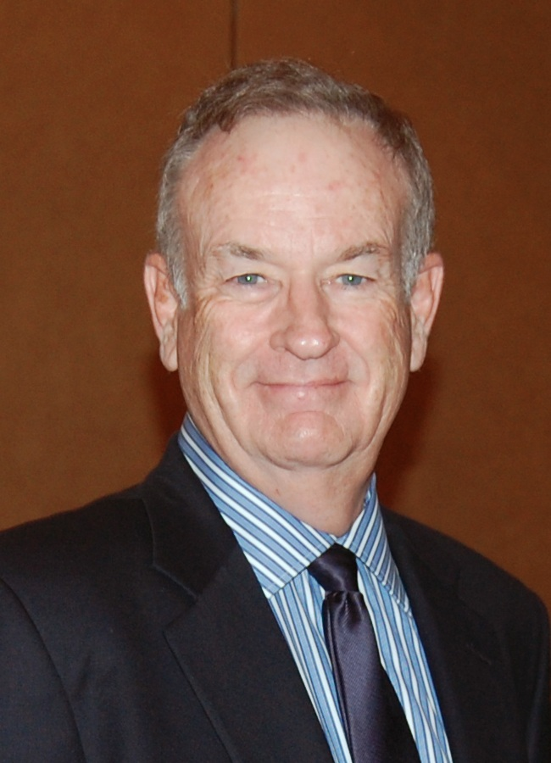
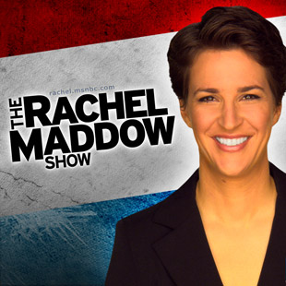

Slide 22
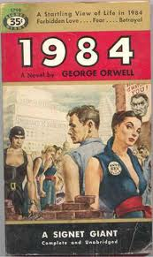

Slide 23
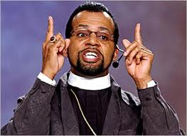
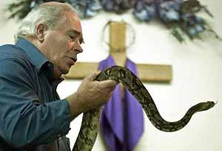

Slide 24
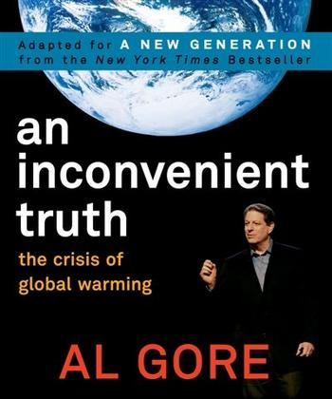

Slide 25
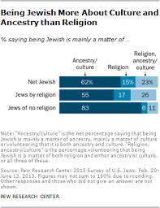

Slide 26
